Slide 1

Yelp Fraud Detection and Explanation
Based on GNN Algorithms
Muhao Chen
2021-11

Slide 2
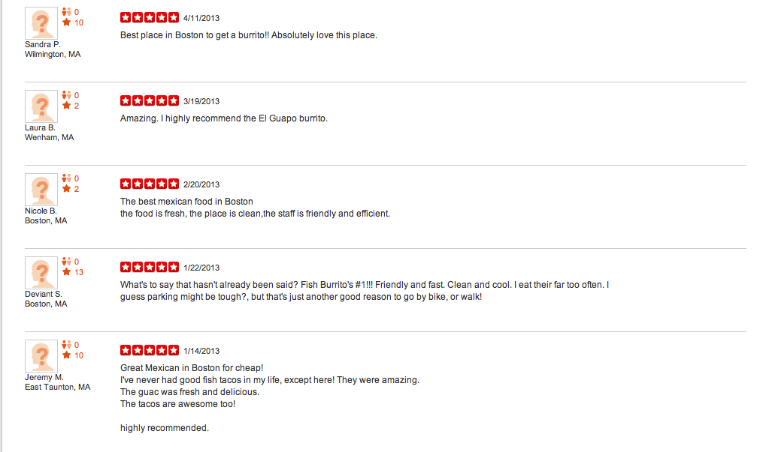
Background
Fake Reviews on Yelp
Relations
Users
User could have some reviews.
Product
Product could have some reviews.
Reviews
Reviews between Users and Products.

Slide 3
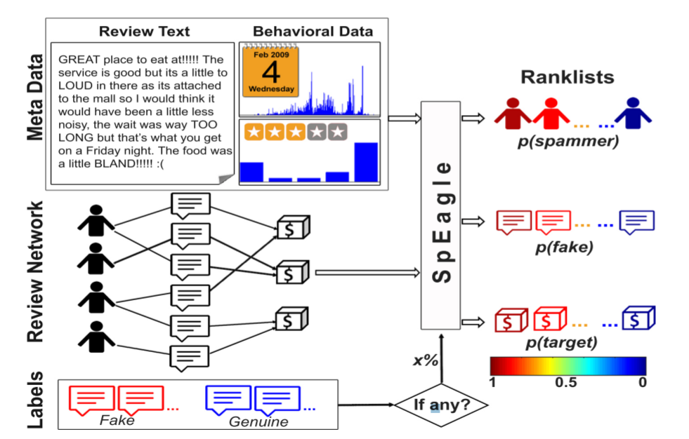
Features
Feature Generated
MetaData
time of reviews, score, reviews content, user id ... ...
Features
Product: rank, deviation ... ...
User: frequency, similarity ... ...
Review: length, similarity ... ...
Reference: Shebuti Rayana and Leman Akoglu. 2015. Collective Opinion Spam Detection: Bridging Review Networks and Metadata.

Slide 4
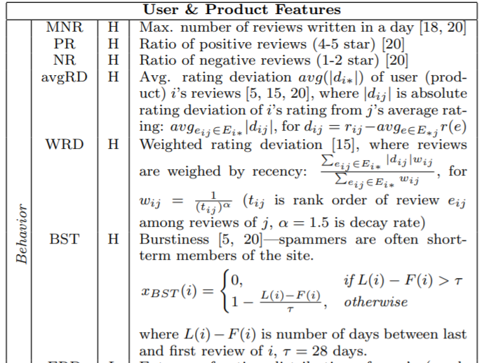
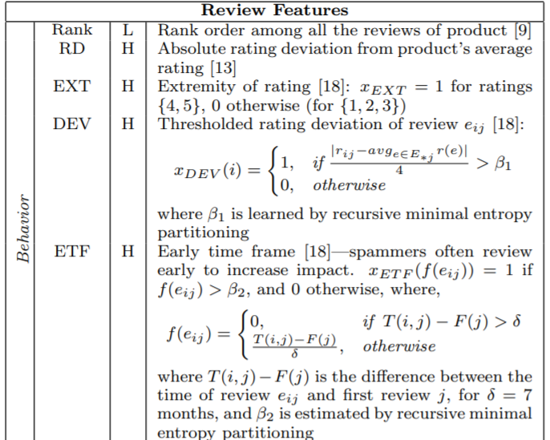
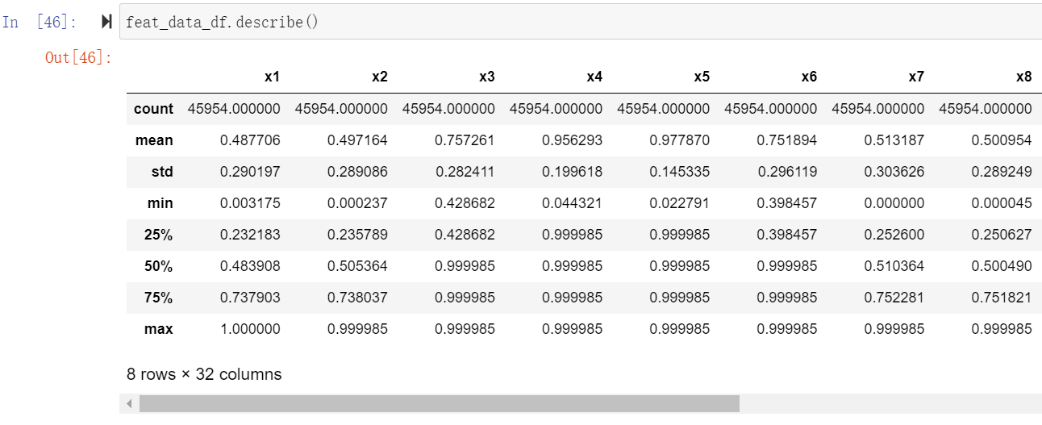
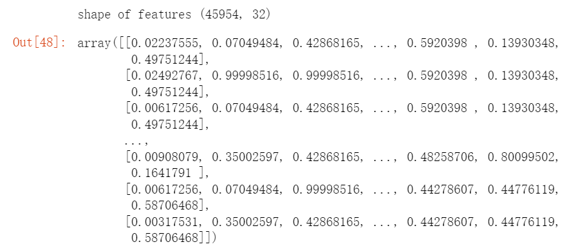
Features Description
32 Features
Reference: Shebuti Rayana and Leman Akoglu. 2015. Collective Opinion Spam Detection: Bridging Review Networks and Metadata.

Slide 5
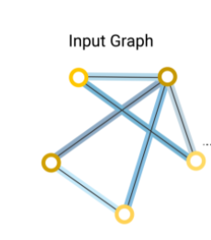
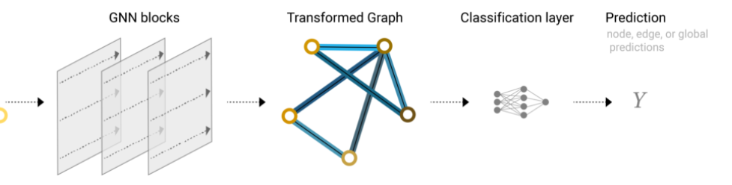
Data Description
Label:
Pos_Lable:6,677
Neg_Lable:39,277
Balance The Labled Data
Relations:
- R-U-R: 98,630
- R-T-R: 1,147,232
- R-S-R: 6,805,486
Train_Data：18,381
Test_Data：27,573
All_Data：45954
Factors：32
Reviews
Reviews
Star
User
Reviews
Reviews
Time
Reviews

Slide 6
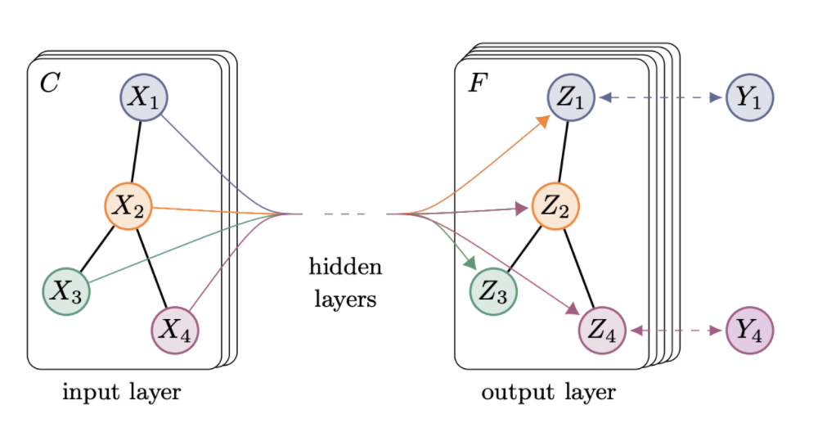
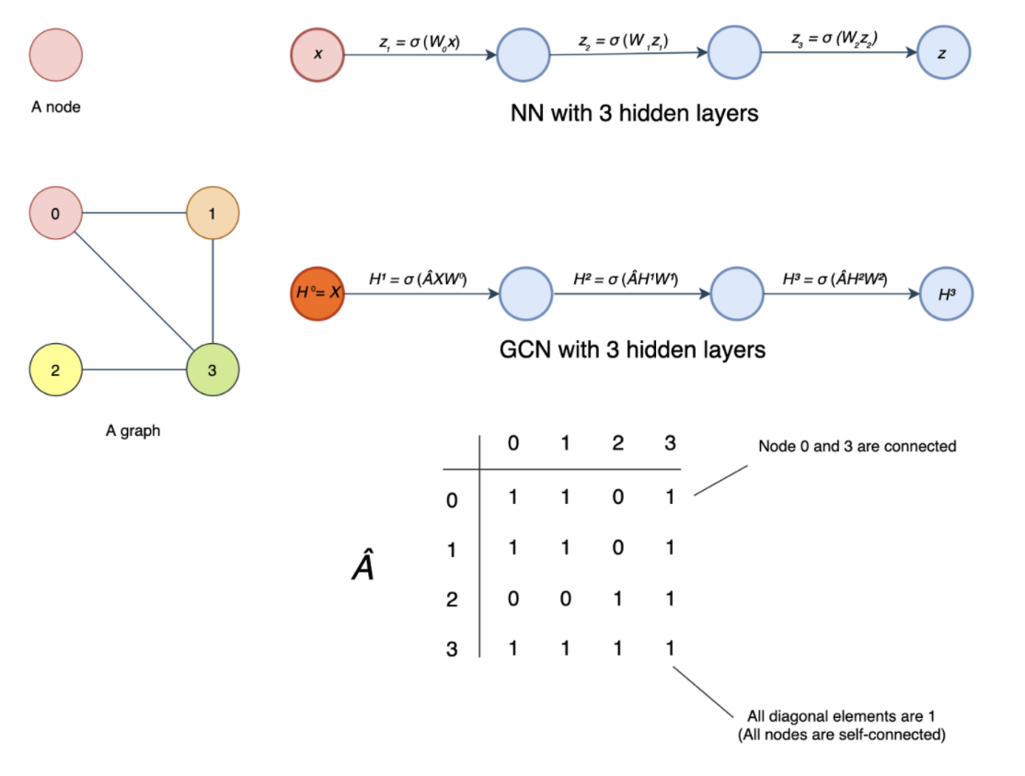
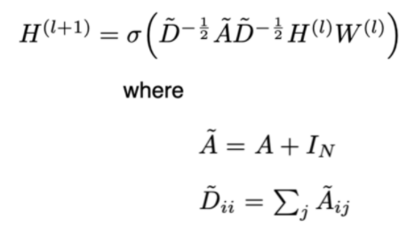
GCN
Transform
Transform Details
Transform Formula
Advantage: Sample, Relu and Aggregation
Drawback: Ignore the Different Weights.
Reference: Thomas N. Kipf, Max Welling, Semi-Supervised Classification with Graph Convolutional Networks

Slide 7
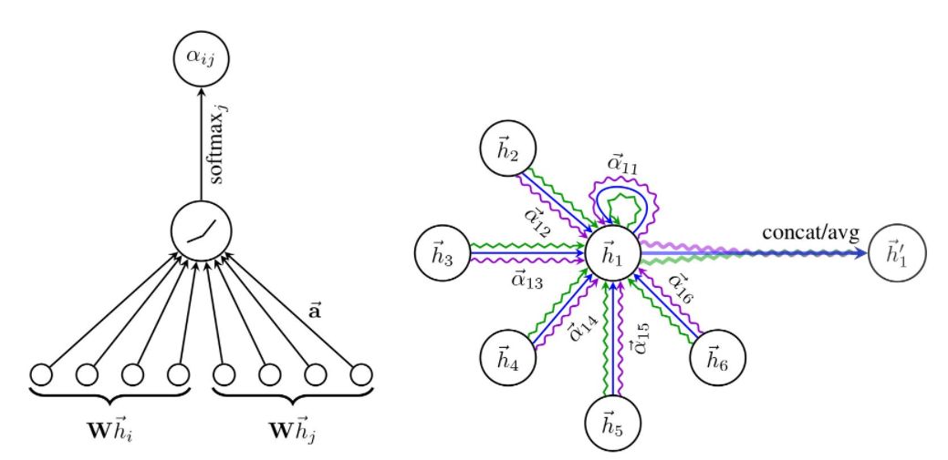
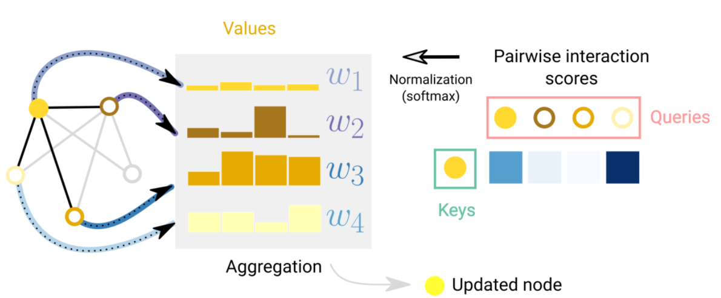
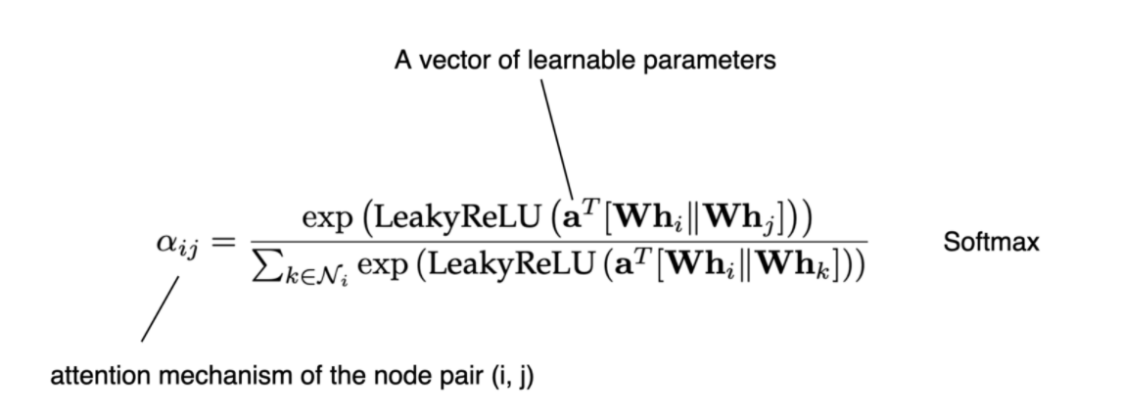
GAT
Attention Aggregation
Attention Function
Attention Formula
Attention explains the information between nodes.
Different neighbors have different impacts.
Using features and LeakyReLU function to compute weights.
Advantage: Pay Attention to Different Weights
Drawback: Forget Relation and Cost Time
Reference: Petar Veličković, Guillem Cucurull, Arantxa Casanova, Adriana Romero, Pietro Liò, Yoshua Bengio, Graph Attention Networks

Slide 8
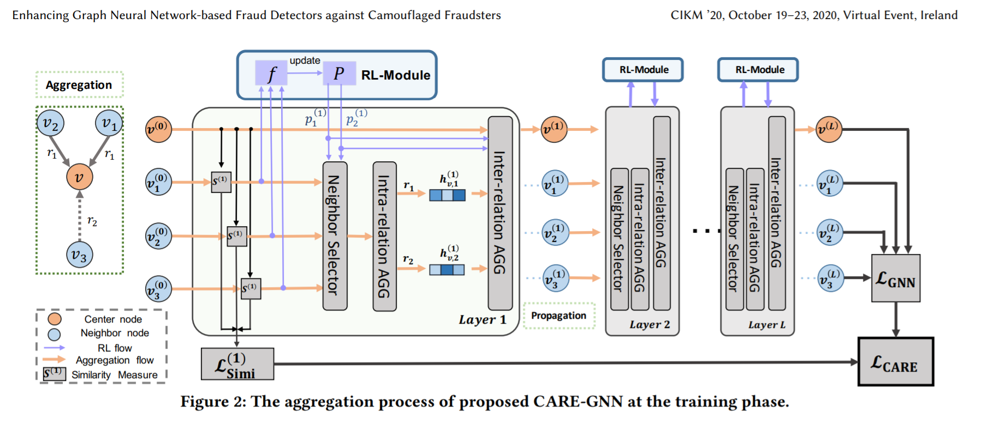
CARE-GNN
Advantage: Focus on Relation, Reinforcement Learning
Reference: Yingtong Dou, Zhiwei Liu, Li Sun, Yutong Deng, Hao Peng, Philip S. Yu
Enhancing Graph Neural Network-based Fraud Detectors against Camouflaged Fraudsters

Slide 9
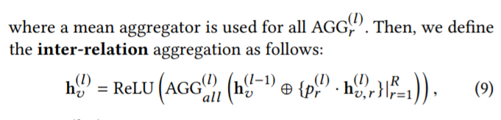
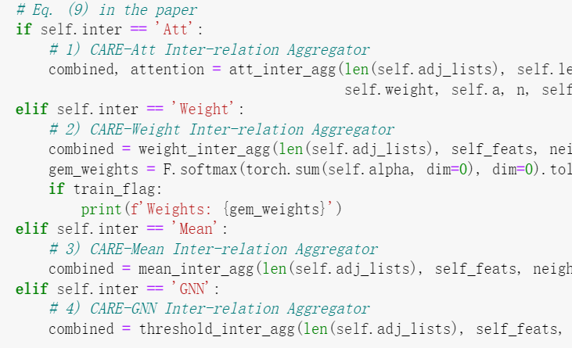
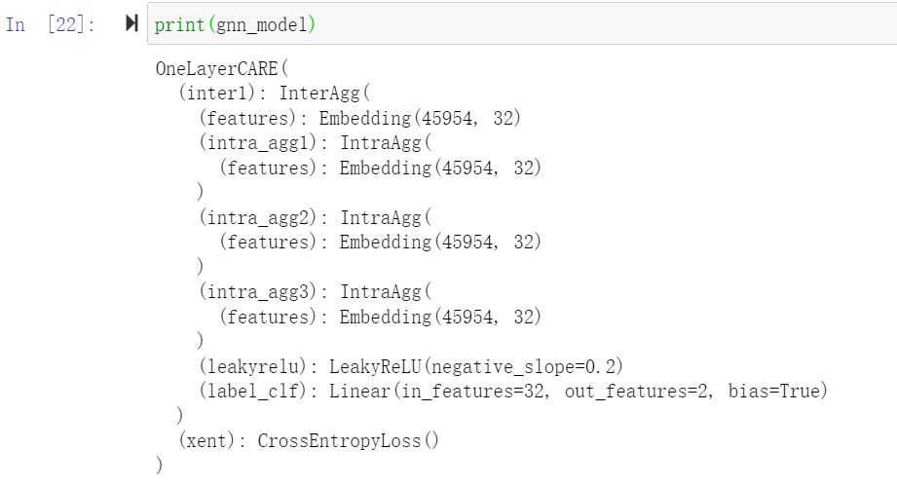
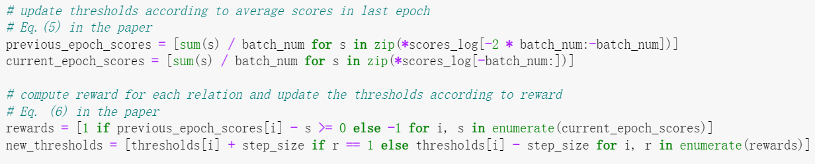
CARE-GNN Layers Code
Neighbor Aggregation Selection
Model Structure
Reinforcement Learning
Reference: Yingtong Dou, Zhiwei Liu, Li Sun, Yutong Deng, Hao Peng, Philip S. Yu
Enhancing Graph Neural Network-based Fraud Detectors against Camouflaged Fraudsters

Slide 10
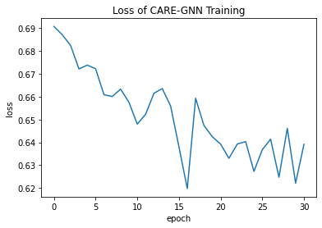
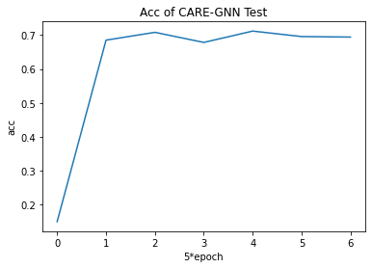
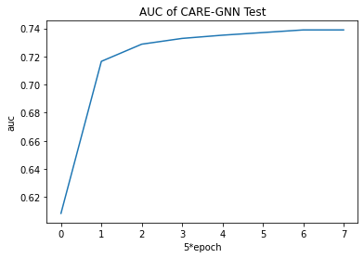
CARE-GNN Performance
Accuracy
69%
Excellent prediction, and loss decrease with time passing by.
I use AUC function to evaluate because the unbalanced dataset.
AUC
74%
Loss of Train
Accuracy of Test
AUC of Test

Slide 11
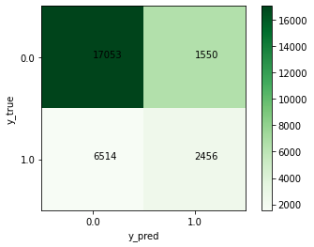
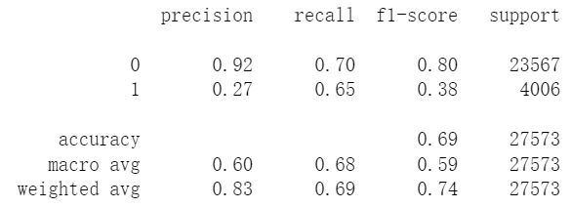
CARE-GNN Performance
Accuracy
69%
Most of fake reviews are detected, which is expected.
However, some other normal reviews are regarded fake ones.
AUC
74%
Evaluation Sheet
Confusion Matrix

Slide 12
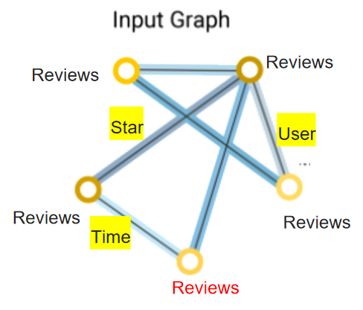
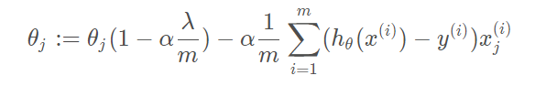
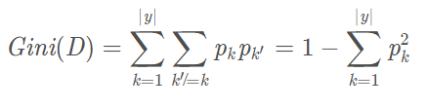

CARE-GNN Feature Explanation
XGBoost 3 Advantages.
1
Support L1 and L2.
Wide
L1: Lasso Regression
L2: Ridge Regression
Decision Tree
2
The target is the residual error, using second Taylor.
Acc
Market_v ?
<=1000亿
>1000亿
turnover ？
RSI?
<=5%
>-6%
3
Fast
1
3
Sample from the column and features.
>5%
<-6%
2
4

Slide 13
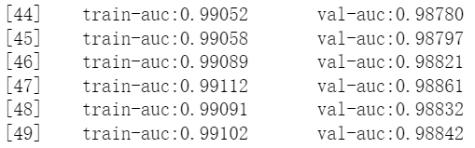
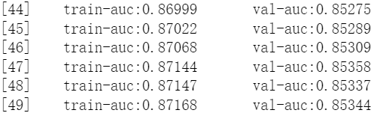
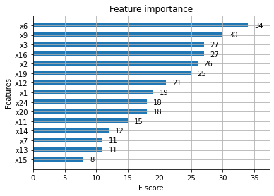
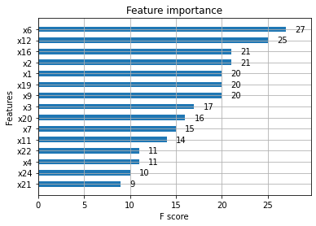
CARE-GNN Feature Explanation
Which Features Explain Prediction ?
Which Features Explain False Prediction ?

Slide 14
Improvement
Features
More Features
More explainable features, including products, users and reviews.
Explaination
Through model itself, it is difficult.
Through additional model, like xgboost or lightGBM.
Alogrithms
Explaination
Alogithms
More different structure and aggregation methods.
GCN, GAT, RGCN and so on.

